Slide 1

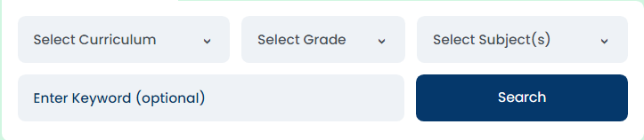


logo
About us
Study techniques
log in
Sign up
Welcome message
Brows for a tutor
graphic
Tutors
More about the serveries we offer
How it will work
User feed back like good reviews about tutors and websit
Contact info
Notes:
home page

Slide 2
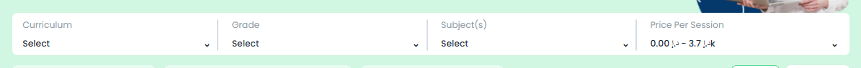
logo
About us
Study techniques
log in
Sign up
Little bio
Little bio
Little bio
subjects
subjects
subjects
Name
Experience in years
grades
Name
Experience in years
grades
Name
Experience in years
grades
curriculums
curriculums
curriculums
Price per session
Price per session
Price per session
Little bio
Little bio
Little bio
subjects
subjects
subjects
Name
Experience in years
grades
Name
Experience in years
grades
Name
Experience in years
grades
curriculums
curriculums
curriculums
Price per session
Price per session
Price per session
Little bio
Little bio
Little bio
subjects
subjects
subjects
Name
Experience in years
grades
Name
Experience in years
grades
Name
Experience in years
grades
curriculums
curriculums
curriculums
Price per session
Price per session
Price per session
Contact info
Notes:
searching tutor page

Slide 3
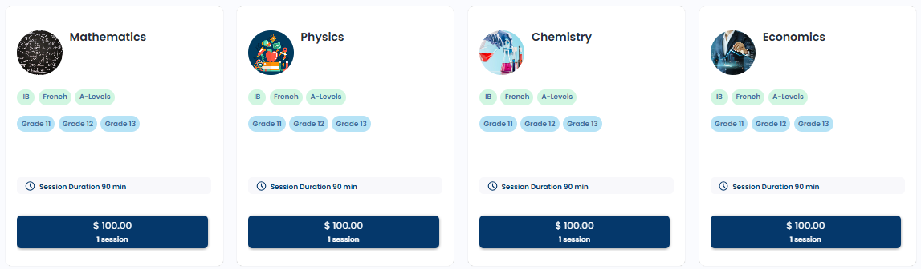
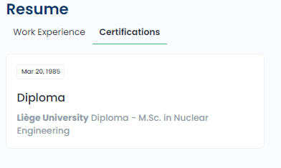

logo
About us
Study techniques
log in
Sign up
bio
Name
Experience in years
reviwes
Contact info
Notes:
A tutor info page

Slide 4

logo
About us
Study techniques
log in
Sign up
EduMentor
How we saw there was a problem
Then we made this website to fix it
Developer info like meet our team
Or just a stock photo
Contact info
Notes:
About us page

Slide 5
logo
About us
Study techniques
log in
Sign up
Study techniques
Tip one
Photo representation of tip
Photo representation of tip
Tip two
Photo representation of tip
Tip three
Contact info
Notes:
Study techniques page

